Slide 1


Student Name: Salma Javid
Enrolment number: 30107961
Module: CS4T702
Faculty of Computing, Engineering and Science
MSc. in Artificial Intelligence
Year: 2023-2024
University of South Wales
Prifysgol De Cymru
MSc. Project
Applications of AI in IVF — Embryo Classification
AI Architect Design Investigation and Comparative Study
Supervisor: Dr. Carl Jones
Senior Lecturer - Computer Games Development

Slide 2
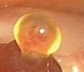
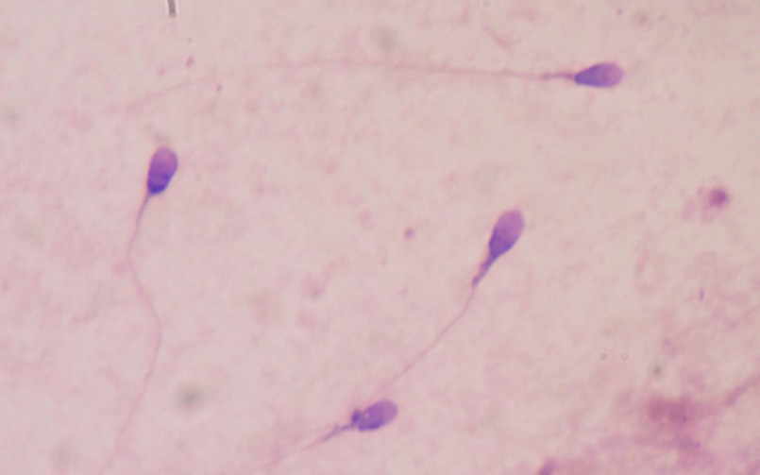
Introduction to IVF
What’s IVF?
IVF is an Assisted Reproductive Technologies (ARTs) which helps people with fertility problems to have a baby.
One egg and one sperm are required for this process.
Egg is the largest cell in a woman’s body.
A human egg is caught on camera as it emerges from a woman's ovary.
Sperm is the smallest cell in a man’s body.
Image 2: Sperm at 400x Zoom
A woman’s egg is fertilized with a man’s sperm in a lab. This way many eggs are fertilized and cultured for 5-6 days — they become Blastocyst stage embryos — Embryologists select the best embryos — transfer to the woman's womb to grow and develop into a beautiful baby.

Slide 3
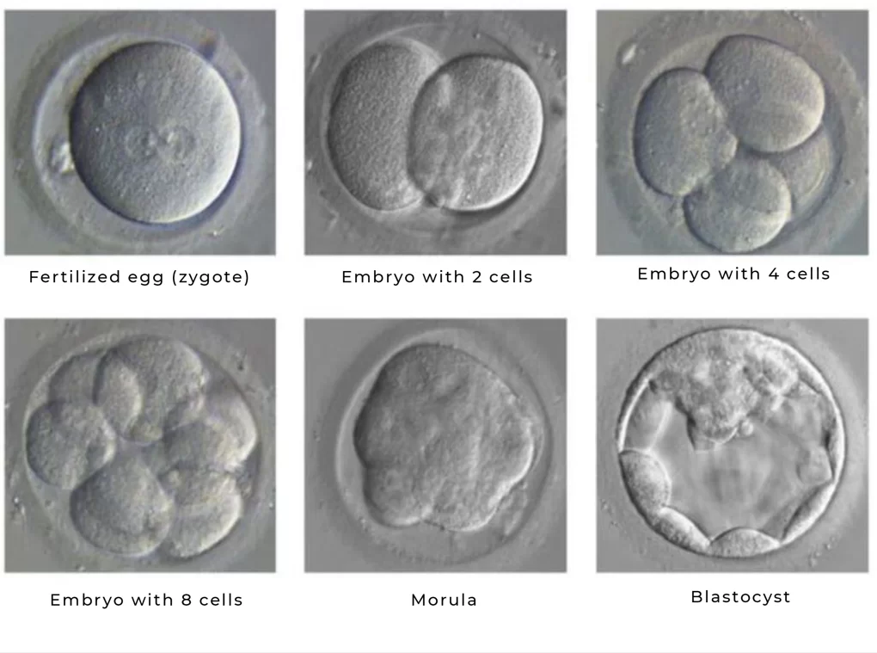
Embryo Stages

Slide 4
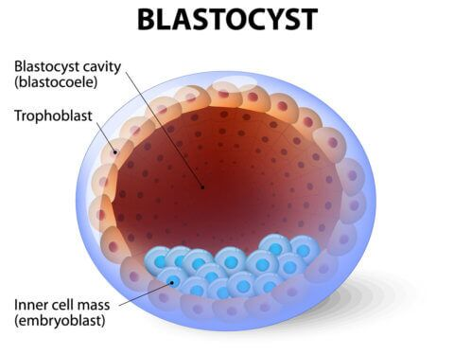
— Day 5 Embryo: Blastocyst
Human embryos, in labs or naturally developing in a woman’s womb, usually reach blastocyst stage by day 5 after fertilization. At this stage, the embryo has 3 distinct parts:
Blastocoel cavity [EXP]: A fluid-filled central cavity.
Inner cell mass [ICM]: It develops into the foetus and body tissues (muscle, brain, bone, etc).
Trophoblast Epithelium [TE] — Outer shell layer responsible for initial implantation into the uterine wall of the mother’s uterus. It becomes the placenta and other tissues. Also facilitates exchange of nutrients and waste between the mother and the developing embryo; crucial for pregnancy maintenance.
All three components play essential roles in the successful development of the baby.

Slide 5
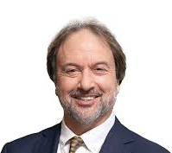
Gardner blastocyst grading system
Assigns 3 separate quality scores to each blastocyst embryo:
Blastocyst Expansion (EXP): Grades the degree of expansion of the blastocyst cavity. Scale: 1 to 6 with 6 being the most advanced.
Inner Cell Mass (ICM): Graded for size and compactness of cells. Scale: A, B, or C with A being the best.
Trophectoderm Epithelium (TE): Graded for cohesiveness and the number of cells Scale: A, B or C; with A being the best.
Each of those factors is combined to create the grade (number, letter, letter). 5AA is the optimal embryo - shows highest quality grading.
Morphological scores of blastocyst are closely associated with the success rates (Sivanantham et al., 2022).

Slide 6
AI Applications in Embryo Classification
Challenges in Manual Assessment:
Highly subjective, varying between practitioners
Time-consuming and prone to human error
Emergence of AI Solutions:
AI uses pattern recognition, machine learning, and time-lapse image analysis for embryo grading
Morphological characteristics of embryos serve as key features for evaluation
Need for Automated Solutions:
AI provides consistent, accurate classification, assisting embryologists in making informed decisions
Improves reliability and reduces variability in embryo quality assessments
Critical Role of AI in IVF:
Accurate classification of early embryo development is vital for IVF success
AI-driven embryo selection enhances decision-making for implantation

Slide 7

AI Applications
In
IVF

Slide 8
Project Details
— Scope of the Study:
To investigate various AI architectures > Perform Evaluation > Identify the best models for embryo classification.
— AI Architect Design Investigation
This study explores the below AI models:
Traditional machine learning models:
Support Vector Machines (SVM) and Random Forests
State-of-the-art Deep Learning Techniques:
CNN, ResNet-50, DenseNet-201, VGG16, InceptionV3, and Xception.
— Comparative Study
Evaluate the strengths and weaknesses of different models helps identify the best method:
Accuracy: How often the model correctly classifies an embryo. Precision: Precision measures the accuracy of the positive predictions Recall: Measures the ability to find all relevant instances. F1 Score: The harmonic mean of precision and recall.

Slide 9
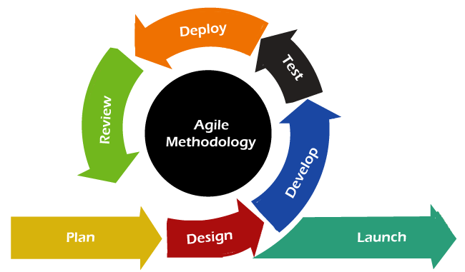
Methodology: Agile
Agile methodology served as the guiding framework.
- Chosen for its flexibility and adaptability.
- Well-suited to the dynamic nature of research and development.
This project is divided into stages, facilitating continuous progress and iteration: Agile's iterative approach allows for continuous refinement and improvement. Agile principles were aimed to maximize efficiency and deliver valuable outcomes.

Slide 10



Tools and Technologies
Essential components used for project development:
Programming Language: Python
Development Environment: Google Colab
Cloud Platforms: Google Cloud

Slide 11
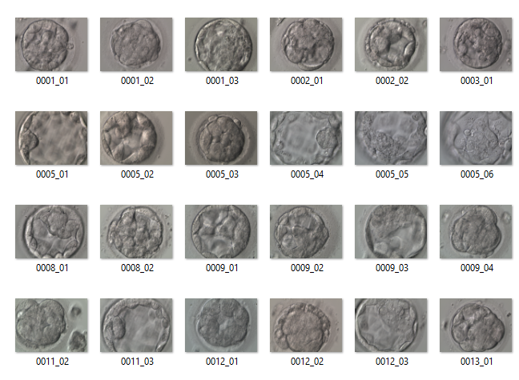
Dataset Description
A total of 2,344 clinically annotated blastocysts (day 5 embryos) from 837 patients in Portable Network Graphics (PNG) format.
Each image is annotated using the Gardner morphological grading system, which evaluates cell expansion (EXP), the quality of the inner cell mass (ICM), and the trophectoderm (TE).

Slide 12
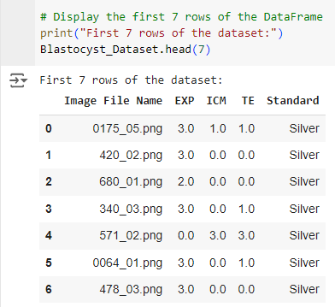
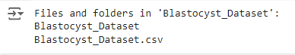
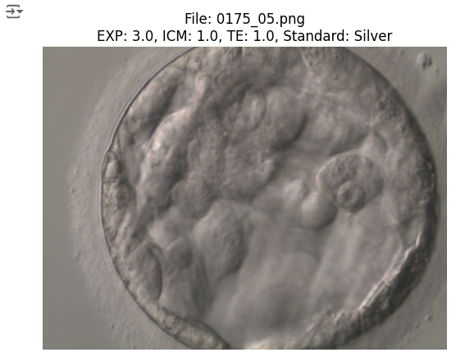
— Database Inspection

Slide 13
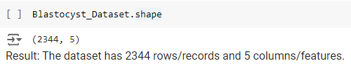
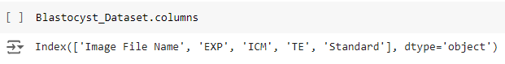
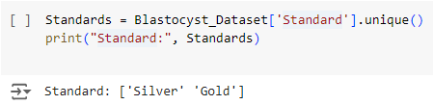
Investigating the dataframe
— Knowing the Shape:
— Listing Columns Names
— Listing Unique Values in Target Column

Slide 14
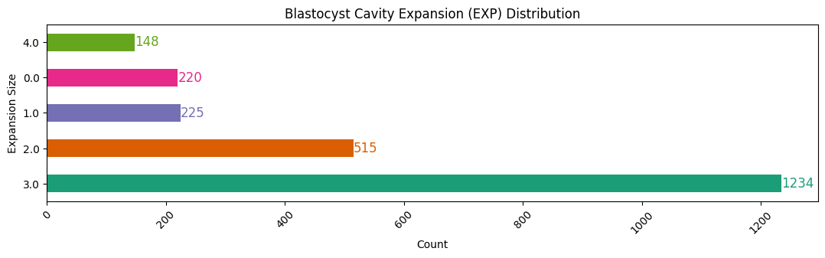
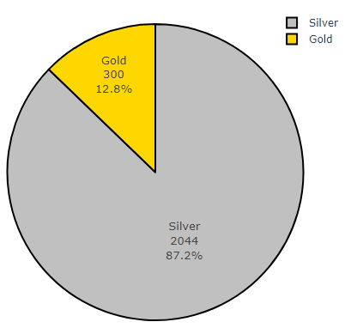
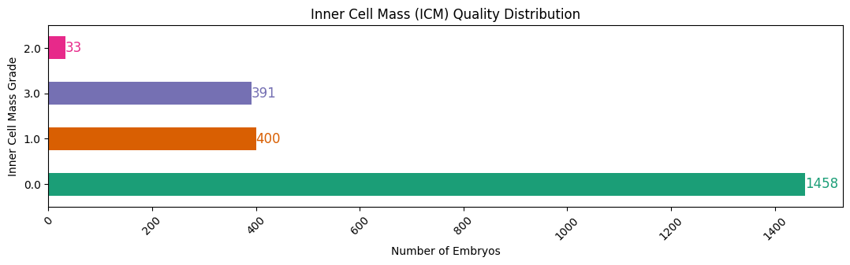
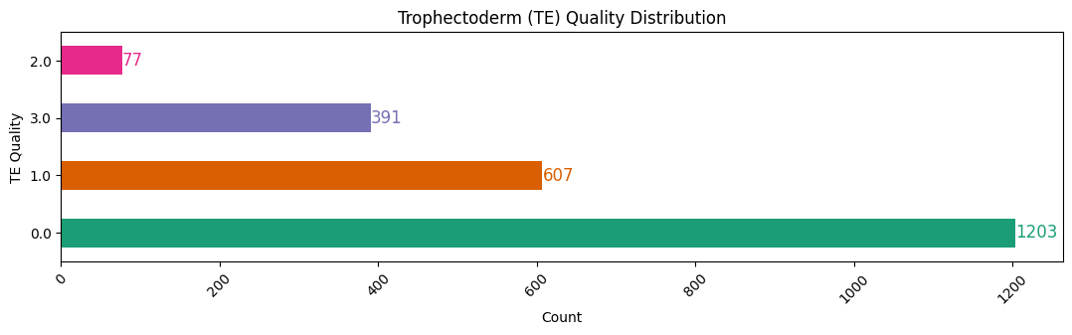
— Data Visualization
The dataframe has 2044 silver standard embryo images [87.2%] and 300 gold standard images [12.8%]

Slide 15
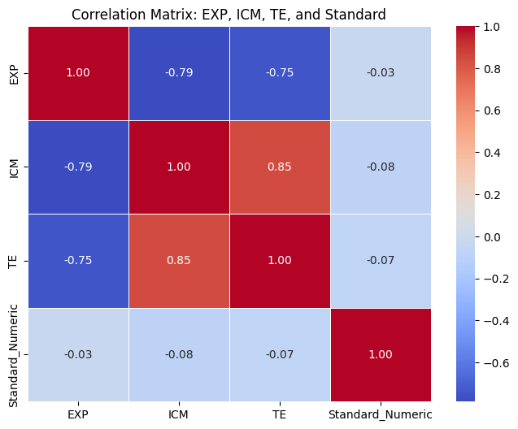
— Correlation Matrix: EXP, ICM, TE, and Standard
Heatmap Interpretation:
Diagonal Values (1.00): These are always 1 as a variable is perfectly correlated with itself.
EXP vs. ICM (-0.82): Strong negative correlation between EXP and ICM, meaning that as EXP increases, ICM decreases.
EXP vs. TE (-0.77): Strong negative correlation between EXP and TE, meaning that as EXP increases, TE decreases.
ICM vs. TE (0.85): Strong positive correlation between ICM and TE, meaning they tend to increase or decrease together.
Standard_Numeric vs. Other Variables: All values close to 0 indicating that the "Standard_Numeric" variable has little to no linear correlation with EXP, ICM, and TE.

Slide 16
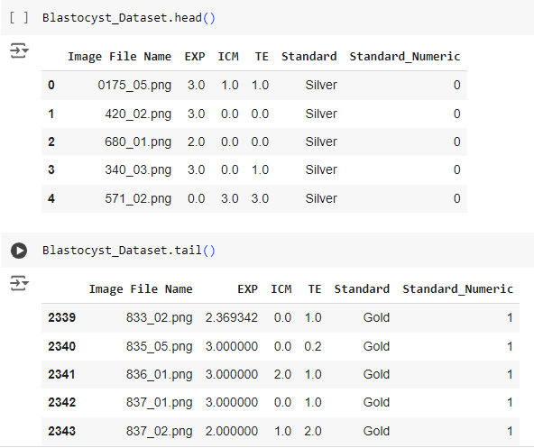
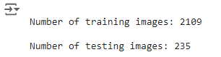
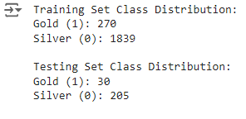
— Feature Mapping
— Splitting the Dataset
Converting the 'Standard' column to numerical values:
Gold = 1, Silver = 0
90% training data and 10% to testing

Slide 17
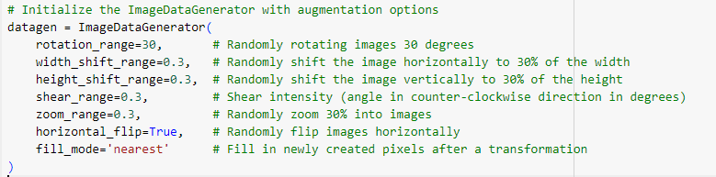
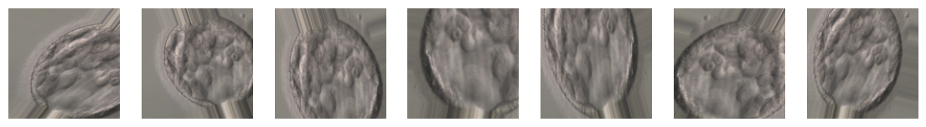
Normalization, Standardization, Resizing & Rescaling
- Resized to `128x128`
- All `image_data` and `labels` are converted to a NumPy array
- Normalization — Image pixel values ranged `[0, 1]` - standard practice in image preprocessing for neural networks
Standardization — scales features to the mean of 0 and a standard deviation of 1 (each feature contributes equally to the model's learning process).
— Image Augmentation

Slide 18
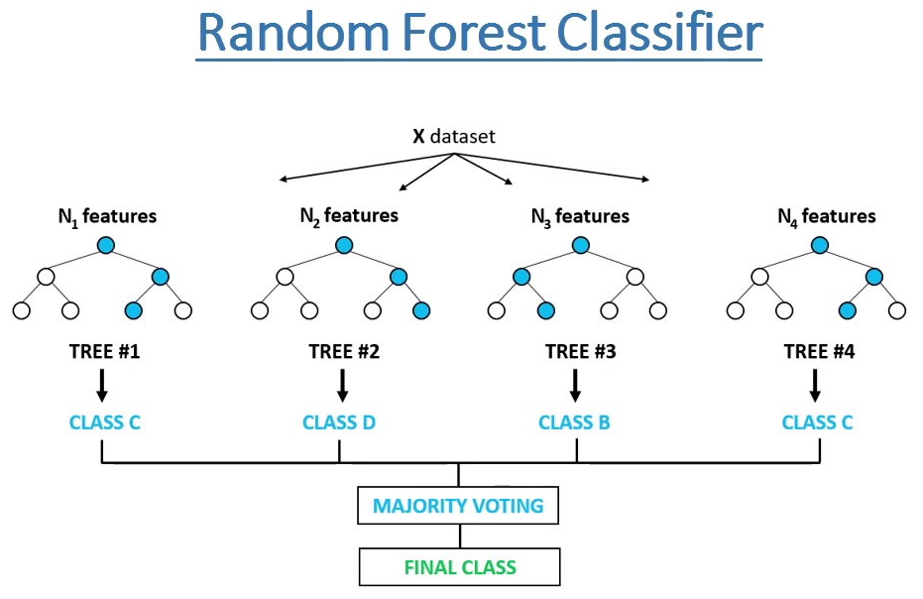
Applying AI Algorithms
Traditional Machine Learning Methods
1 — Random Forest Classification [RFC]
A traditional supervised ensemble machine learning algorithm used for classification tasks. It builds a forest of decision trees by selecting random subsets of data and features during training and combines their predictions for results. This reduce overfitting and increases the model's robustness
Results
Accuracy: 0.85: The model correctly classified 85% of the images overall.
Precision: 0.00: The ratio of true positives to the sum of true positives & false positives. 0.00 score means that the model did not correctly identify any instances of Gold class.
Recall: 0.00: Ratio of true positives to the sum of true positives and false negatives. 0.00 score means the model did not identify any Gold class instances at all.
F1 Score: 0.00: The harmonic mean of precision and recall. 0.00 score means the model’s F1 score for the Gold class is zero.

Slide 19
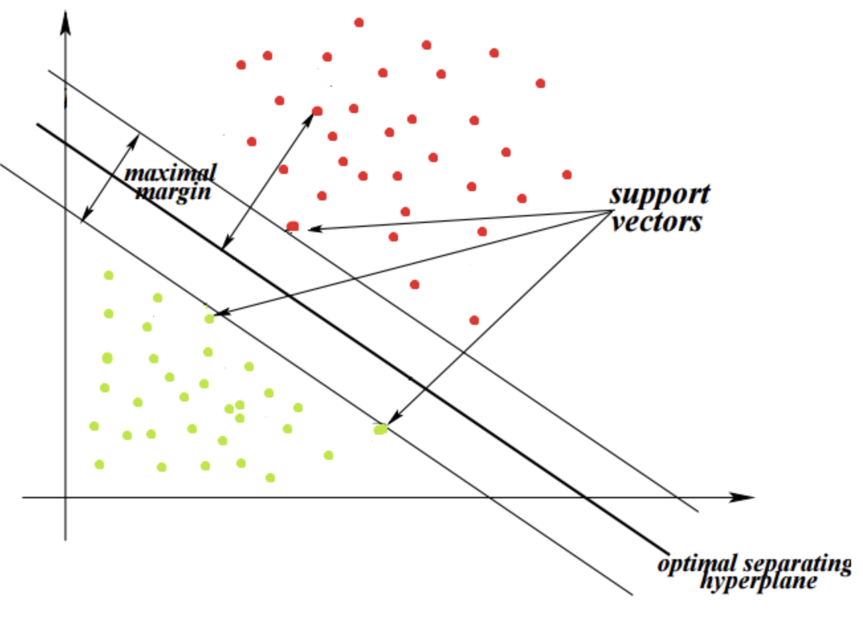
2 — Support Vector Machines [SVM]
A supervised machine learning algorithm for complex classification problems.
Its finds an optimal line [hyperplane] maximizing the distance between each class in an N-dimensional space effectively
Architecture: Images resized to 128x128 pixels, converted to grayscale, normalized pixel values btwn 0 and 1 and flattened into 1D arrays. A Support Vector Classifier (SVC) with a linear kernel is used as the classifier.
Results: SVM Accuracy: 0.81 SVM Precision: 0.25 — Low indicates many false positives [only 25% gold were correctly identified] SVM Recall: 0.23 — Correctly identified only 23% of the actual Gold instances SVM F1 Score: 0.2 — reflects poor performance in both precision and recall for the Gold class.
Interpretation: Class Imbalance — Model performs well on the Silver but poorly on the Gold class [a strong bias toward the majority Silver class].

Slide 20
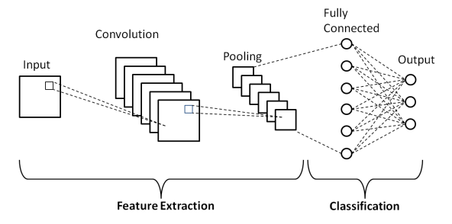
3 — Convolutional Neural Networks [CNN]
CNN is a deep learning model - fundamental in computer vision for their ability to learn intricate visual patterns. Typically used for image classification, object detection and segmentation tasks
— Employs convolutional layers to learn spatial hierarchies of features [edges, textures, and complex shapes to capture patterns].
Model Performance Results: Accuracy: 87.23% — Correctly classified 87.23% of the images — high accuracy. Precision: 0.00% — None of the instances predicted as Gold were actually Gold. Recall: 0.00% — Model did not correctly identify any of the actual Gold instances. F1 Score: 0.00 — Both precision and recall are zero for the Gold class.

Slide 21
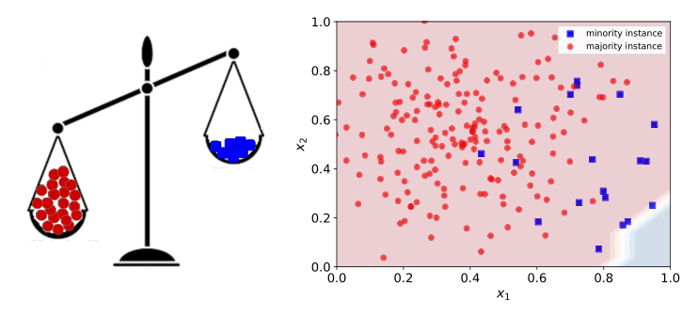
Class imbalance — Explained
If the majority of the embryos are "Silver" and only a few are "Gold," the model might be biassed toward predicting "Silver," leading to higher accuracy but poor performance in detecting "Gold."

Slide 22
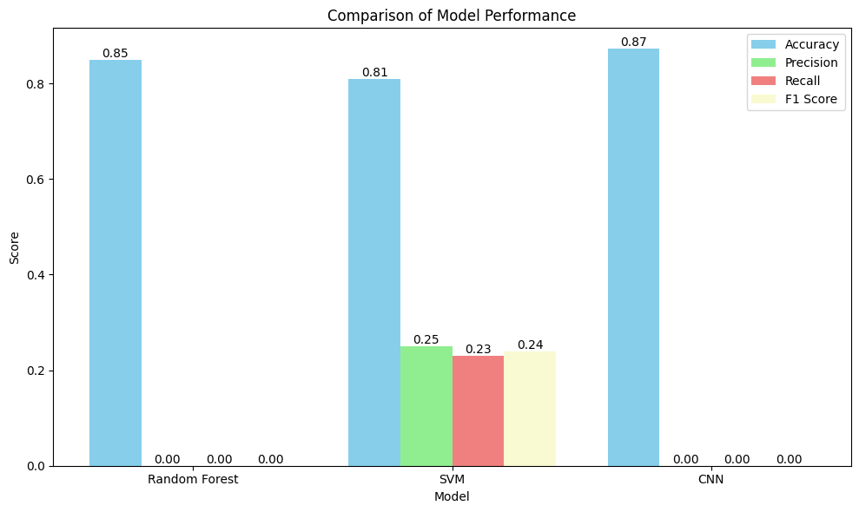
Performance Comparison: RFC, SVM and CNN
Comparison Chart
Random Forest:
Accuracy: 85%
Precision, Recall, F1 Score: 0.00, indicating ineffective classification.
SVM:
Accuracy: 81%
Precision: 0.25, Recall: 0.23, F1 Score: 0.24, suggesting some prediction of both classes but with low overall performance.
CNN:
Accuracy: 87%
Precision, Recall, F1 Score: 0.00, similar issue as Random Forest.
Conclusion: Class imbalance issue.

Slide 23
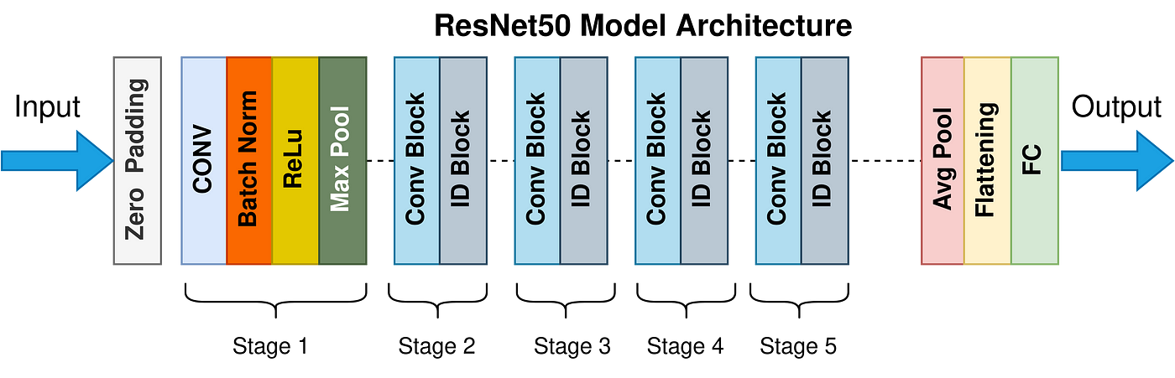
Transfer Learning
4 — ResNet-50: The model is pre-trained on ImageNet, particularly beneficial for reducing overfitting in small datasets. Technically it is a deep CNN with 50 layers, known for residual learning. It balances depth and complexity well and can handle imbalanced datasets. ResNet-50 is a popular architecture for image classification and other computer vision tasks due to high accuracy and ease of training.
Model Performance Results: Same as CNN

Slide 24
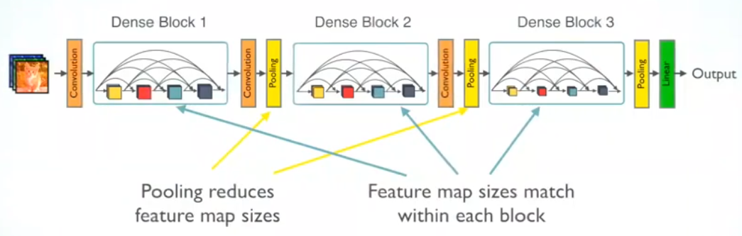
5 — DenseNet 201
DenseNet-201 is a very deep convolutional neural network with 201 layers, advantageous for learning complex patterns in the data. In this architecture, each layer is directly connected to every other layer, ensuring maximum information flow and efficient feature reuse. This architecture excels in image classification tasks, offering high performance while maintaining computational efficiency.
Model Performance Results: Same as CNN

Slide 25
Advanced Algorithms
6 — VGG 16, Inception V3, Xception
VGG16: Introduced by the Visual Geometry Group, VGG16 is known for its simplicity and uniform architecture. Consisting of 16 layers with small 3x3 convolutional filters and 2x2 max pooling layers. Given the dataset size, it might be effective for learning initial patterns.
InceptionV3: Developed by Google, InceptionV3 combines multiple convolutional filters of different sizes to capture various feature scales within a single layer. It handles varying feature sizes well and can be a good choice for balancing performance and efficiency. Reduces computational cost compared to VGG16, while maintaining high performance.
Xception: An extension of InceptionV3, Xception replaces the standard convolutional layers with depthwise separable convolutions, further optimizing efficiency. This approach improves performance and reduces the number of parameters, making it well-suited for complex tasks with limited computational resources.
Model Performance Results: Same as CNN

Slide 26
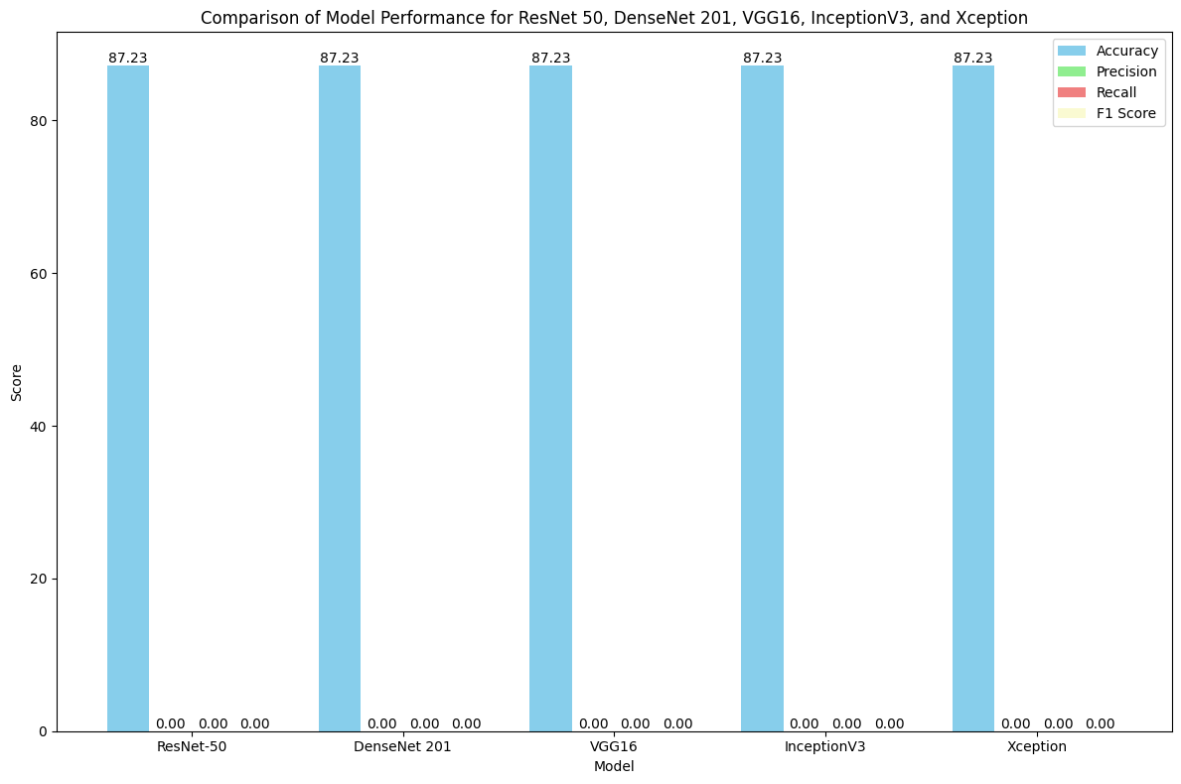
Performance Comparison: ResNet-50, DenseNet 201, VGG16, InceptionV3, and Xception
In the chart:
- Accuracy is represented by light blue bars.
- Precision, Recall, and F1 Score all show values of 0.00 for each model.
Observations:
- Accuracy for each model (ResNet-50, DenseNet 201, VGG16, InceptionV3, Xception) is exactly 87.23%.
- However, the metrics for precision, recall, and F1 score are all 0.00, which indicates imbalance in the classes. This is happening as the models are predicting only one class for the entire test set leading to poor scores for precision, recall, and F1 score.

Slide 27
7 — Xception model with SMOTE
Addressing Class Imbalance: To improve detection of the underrepresented "Gold" class, we use SMOTE (Synthetic Minority Oversampling Technique). It generates synthetic samples for minority gold class thus balances the dataset and prevents bias towards the majority class.
Result:
Accuracy: 76.17% – the model correctly predicted 76.17% of the total cases {accuracy can be misleading, if there’s class imbalance}.
Precision: 0.09 — quite low, meaning that of the samples the model predicted as positive (e.g., "Gold"), only 9% were actually positive. Suggests a high number of false positives (model predicted gold when it was silver).
Recall: 0.10 — quite low. Of the actual positive samples (e.g., actual "Gold" embryos), the model only identified 10%. This indicates a high number of false negatives, where the model failed to detect actual "Gold" embryos.
F1 Score: 0.10 — Low again; it highlights that the model is not performing well in balancing both precision and recall.
This indicates class imbalance.

Slide 28
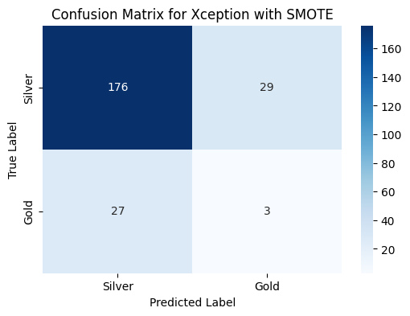
Confusion matrix for Xception model with SMOTE
Results Explained:
176 samples were correctly predicted as Silver (true negative).
29 Silver samples were incorrectly predicted as Gold (false positive).
27 Gold samples were incorrectly predicted as Silver (false negative).
Only 3 samples were correctly predicted as Gold (true positive).

Slide 29
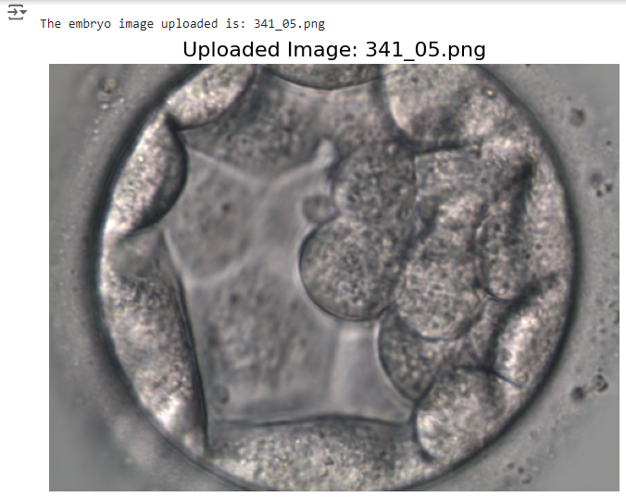
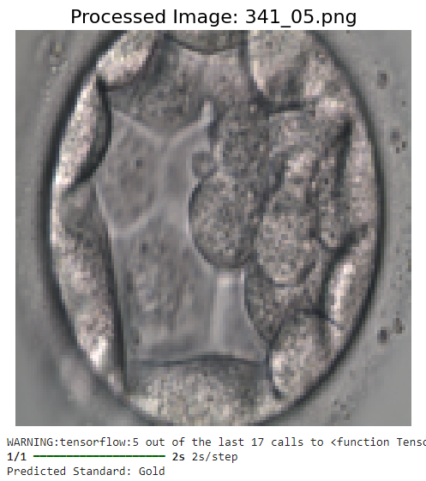
Project Artefact [Prototype]
— Features
Prototype demonstrates an AI-based embryo classification tool, which employs the Xception model to classify embryo images into Gardner's Gold or Silver standard. The primary features are:
User-Friendly: Users can upload an embryo image directly through the interface.
Image Preprocessing: Uploaded images are automatically resized, normalized, and converted into the appropriate format for input into the neural network.
Classification: Prototype utilizes the pre-trained Xception model. Custom layers have been added to tailor the model for binary classification specific to embryo grading.
Prediction Output: Gardner's Gold or Silver standard. This immediate feedback is crucial for clinicians or researchers seeking to quickly evaluate embryo quality.
Visual Feedback: The uploaded image and its preprocessed version are displayed, offering a visual confirmation to the user.

Slide 30
Future Work
Universal AI Embryo Evaluation Tool
Goal: Develop an AI tool for global use in IVF labs to classify embryos and assist clinicians in selecting the best embryo for successful transfers.
Considerations: Account for lab conditions, patient profiles (ethnicity, age, medical history), and IVF cycle variables.
Training: Use diverse, multicenter datasets to ensure model reliability across different regions and populations.
Future Focus: Incorporate advanced AI techniques for segmenting embryo components (EXP, ICM, TE), integrate personal and clinical factors, and validate through large-scale, multicenter trials.

Slide 31
